Slide 1
TRANSWESTERN PIPELINE COMPANY
2002 PLAN REVIEW
November 8, 2001

Slide 2
TRANSWESTERN PIPELINE COMPANY
Table of Contents
Transwestern Pipeline Company – Steve Harris
ETS-3 Commercial Contribution
ETS-4 Red Rock Expansion
ETS-5 Expansions to California
ETS-6 Expansions to California
ETS-7 NYMEX Prices
ETS-8 2002 Basin & Border Prices
ETS-9 2002 Basin to Border Spreads

Slide 3
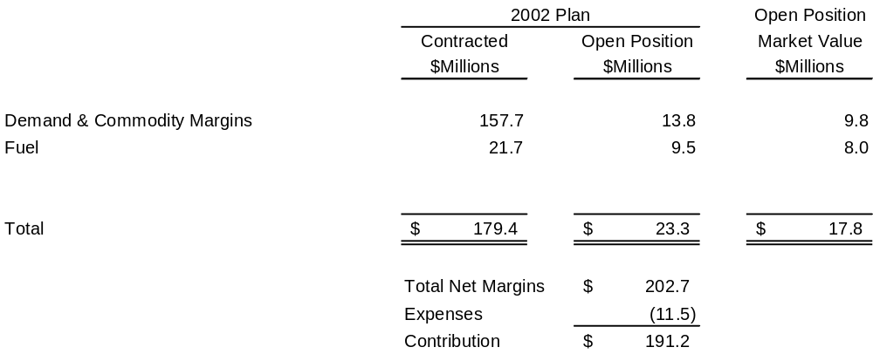
Transwestern Pipeline Company
Commercial Group 2002 Operating Plan
Commercial Contribution
(Millions)

Slide 4
Transwestern
Pipeline Company
Red Rock Expansion
•
Incremental 120,000/d delivered
to California & East of California
•
Additional hp at Stations 1, 2 & 3
NV
•
1.210
Bcf
/d total deliveries West
NV
UT
•
Supplies from East of Thoreau
UT
CO
CO
CA
CA
•
In
-
service June, 2002
3
•
106,700/d subscribed, resulting in
1
3
1
2
2
17.2 % ROE (15.5 % DCF)
AZ
AZ
NM
NM
TX
TX

Slide 5
Transwestern Pipeline Company
Expansions to California
Filed With the FERC
Project | In-Service | Volume
TW Red Rock | June, 2002 | 150,000/d
EPNG | August, 2001 | 230,000/d
PGT (Ph I) | November, 2001 | 200,000/d
Southern Trails | July, 2002 | 120,000/d
Kern River | May, 2002 | 125,000/d
Kern River | May, 2003 | 885,000/d
TOTAL |  | 1,710,000/d

Slide 6
Transwestern Pipeline Company
Additional Expansions
Announced
Project | In-Service | Volume
TW Sun Devil | January, 2004 | 330,000/d
Sonoran (Ph I) | Summer, 2003 | 750,000/d
EPNG | Summer, 2003 | 320,000/d
PGT | November, 2003 | 400,000/d
CIG Ruby | December, 2003 | 750,000/d
TOTAL |  | 2,550,000/d

Slide 7
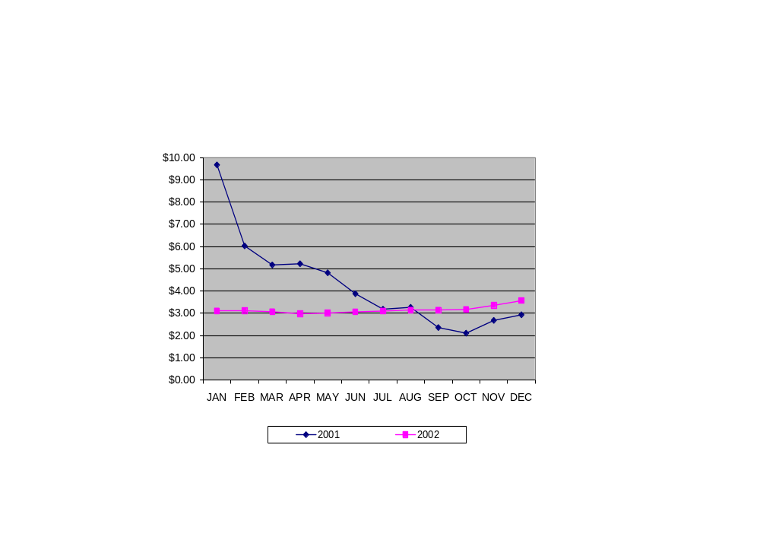
Transwestern Pipeline Company
NYMEX Prices
($/MMBtu)
$ 3.15 average
$ 4.28 average

Slide 8
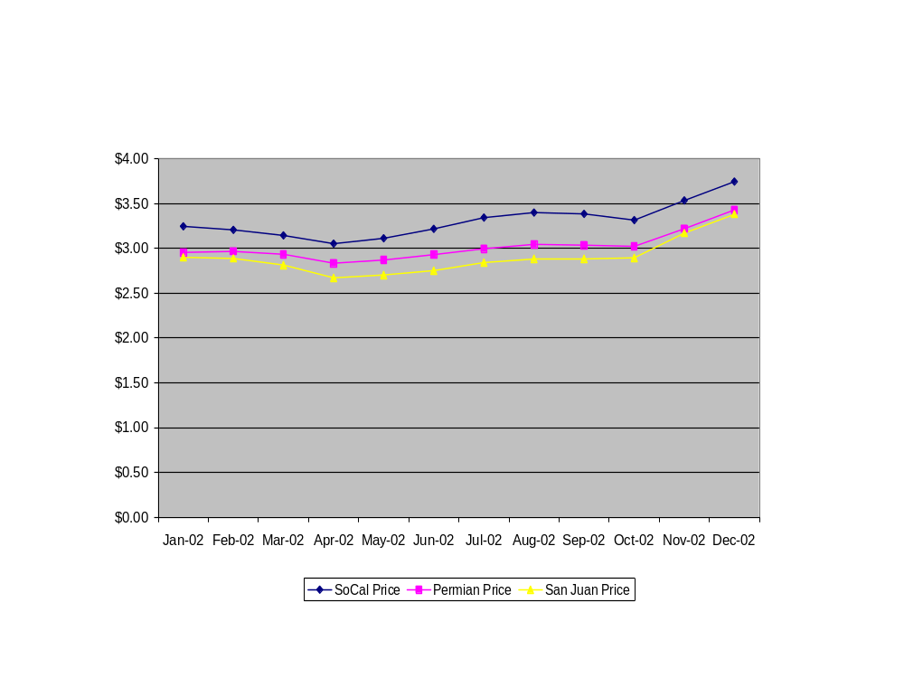
Transwestern Pipeline Company
2002 Basin & Border Prices
($/MMBtu)

Slide 9
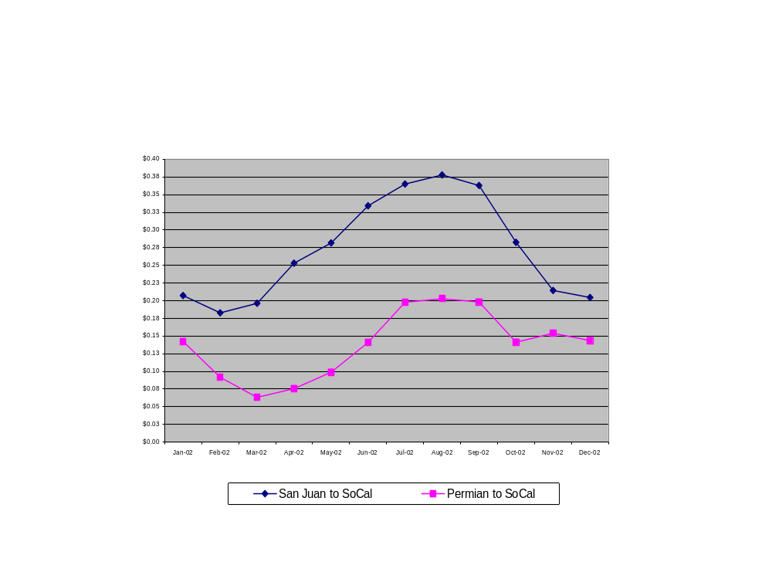
Transwestern Pipeline Company
2002 Basin to Border Spreads*
($/MMBtu)
$ 0.27 average
$ 0.14 average
* Spreads are net of fuel.

